Slide 1
Graph Theory
Dr Honey Sharma
GGI, Ludhiana
Reference Book: Kenneth H. Rosen, Discrete Mathematics and its Applications, 7th ed, McGraw Hill

Slide 2
Graph Coloring Problem
A coloring of a simple graph is the assignment of a color to each vertex of the graph so that no two adjacent vertices are assigned the same color.
A graph can be colored by assigning a different color to each of its vertices. However, for most graphs a coloring can be found that uses fewer colors than the number of vertices in the graph.
What is the least number of colors necessary?

Slide 3
The chromatic number of a graph is the least number of colors needed for a coloring of this graph. The chromatic number of a graph G is denoted by χ(G).
A graph that can be assigned a k-coloring is k-colorable, and it is k-chromatic if its chromatic number is exactly k.

Slide 4
Two things are required to show that the chromatic number of a graph is k. First, we must show that the graph can be colored with k colors. This can be done by constructing such a coloring.
Second, we must show that the graph cannot be colored using fewer than k colors.
THE FOUR COLOR THEOREM
The chromatic number of a planar graph is no greater than four.

Slide 5
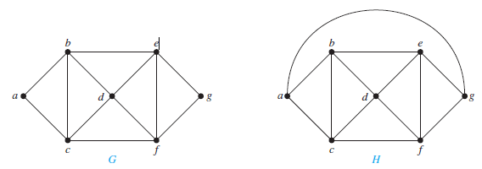
What are the chromatic numbers of the graphs G and H?

Slide 6
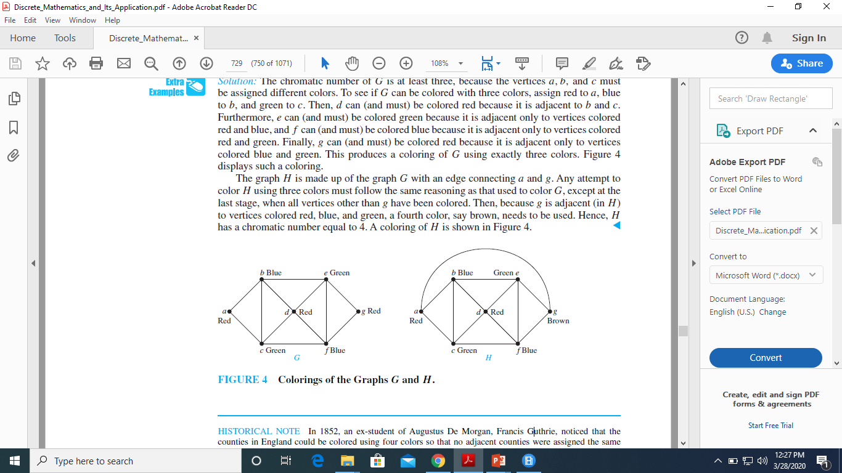
Solution: The chromatic number of G is at least three, because the vertices a, b, and c must be assigned different colors.
To see if G can be colored with three colors, assign red to a, blue to b, and green to c.

Slide 7
The graph H is made up of the graph G with an edge connecting a and g. Any attempt to color H using three colors must follow the same reasoning as that used to color G, except at the last stage, when all vertices other than g have been colored.

Slide 8
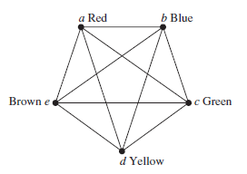
What is the chromatic number of Kn?
Solution : No two vertices can be assigned the same color, because every two vertices of this graph are adjacent. Hence, the chromatic number of Kn is n.

Slide 9
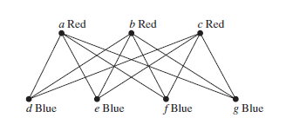
What is the chromatic number of the complete bipartite graph Km,n, where m and n are positive integers?
Solution: χ(Km,n) = 2.

Slide 10
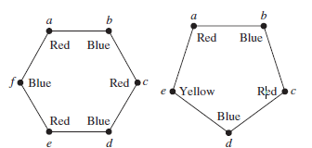
What is the chromatic number of the graph Cn, where n ≥ 3? (Recall that Cn is the cycle with n vertices.)
Solution:
χ(Cn) = 2 if n is an even positive integer with n ≥ 3
χ(Cn) = 3 if n is an odd positive integer with n ≥ 3.

Slide 11
Applications of Graph Colorings
Scheduling
Vertex coloring models to a number of scheduling problems. Jobs can be scheduled in any order, but pairs of jobs may be in conflict in the sense that they may not be assigned to the same time slot. The corresponding graph contains a vertex for every job and an edge for every conflicting pair of jobs.
The chromatic number of the graph is exactly the minimum makespan, the optimal time to finish all jobs without conflicts.

Slide 12
Frequency Assignments Television channels 2 through 13 are assigned to stations in North America so that no two stations within 150 miles can operate on the same channel. How can the assignment of channels be modeled by graph coloring?
Solution: Construct a graph by assigning a vertex to each station. Two vertices are connected by an edge if they are located within 150 miles of each other. An assignment of channels corresponds to a coloring of the graph, where each color represents a different channel.

